Slide 1
MLOps Web-Editor
Daniil Fedorov, Sergeev Ilya, Shtanov Andrey, Daragan Daniil

Slide 2
MLDev experiments web application
A web-editor for pipelines with auto-saving and automatic syntax and cohesion checking, embedded into the “MLOps Platform”.
MLDev experiments pipelines configurations CRUD.
Online editor with syntax highlighting, formatting.
Executable experiment control panel.
Built-in git support system.
Built-in authorization system.
Team: Daniil Fedorov, Sergeev Ilya, Shtanov Andrey, Daragan Daniil
Project repo: https://github.com/dr0p-table-users/asd
This report: https://docs.google.com/presentation/d/1nZmJWSpytLEOG-2TrB37oQ8E7vVs-HiyGGWIwNoLjpE/edit#slide=id.gebdfeb45a5_0_0

Slide 3



Personas
Danil Danilich <Data Analytic>
A blue T-shirt man who works as Data Analytic. He is using MLDev experiment pipelines, but tired from lack of syntax highlighting and CI/CD.
Wiki page: https://en.wikipedia.org/wiki/Data_analysis
Andrey Andreyich <ML Ops Engineer>
A red T-shirt man who works as MLOps Engineer with 100 clones of Daniil Daniilich. He is tired that all data analytics in his company run MLDev pipelines in their inconsistent environments leading to lots of errors.
Wiki page: https://en.wikipedia.org/wiki/MLOps

Slide 4
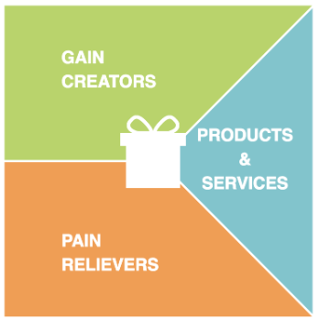
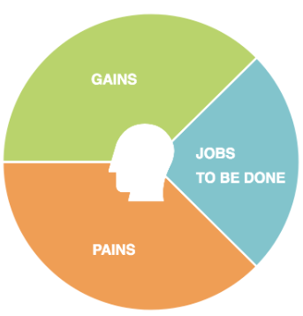
Value proposition canvas. Danil Danilich <Data Analytic>
Web UI instead of CLI. Plugin for experiment.yaml for vscode
MLDev experiments web application. Jenkins. Bash. Python
Wants to use preconfigured automated data pipelines for everyday work without writing bash scripts
Wants to use an automated data pipelines from MLDev via web interface
Use YAML text editor. Use Jenkins with bash scripts.
No mldev yaml syntax highlighting. No UI solution. No CI/CD

Slide 5
Value proposition canvas. Andrey Andreyich <ML Ops Engineer>
Web UI available for anyone with a browser
MLDev experiments web application. Jenkins. Bash. Python
Wants to configure 1 environment instead of 100 ones
Wants to use an web interface for MLDev infrastructure
Use RDP.. Use Jenkins. Use bash/python scripts.
Data Analytics get lots of errors due to their environments. Deployment is not possible

Slide 6
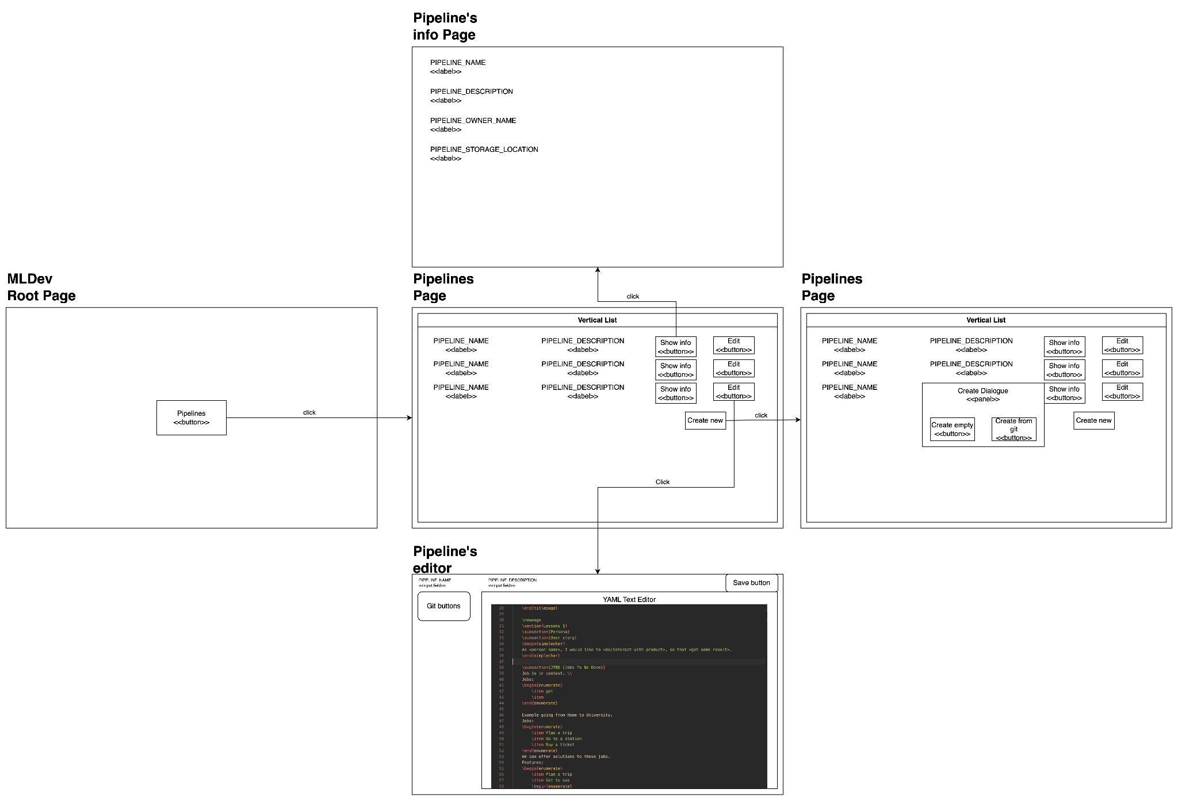
Prototype User Interfaces (wireframes)

Slide 7
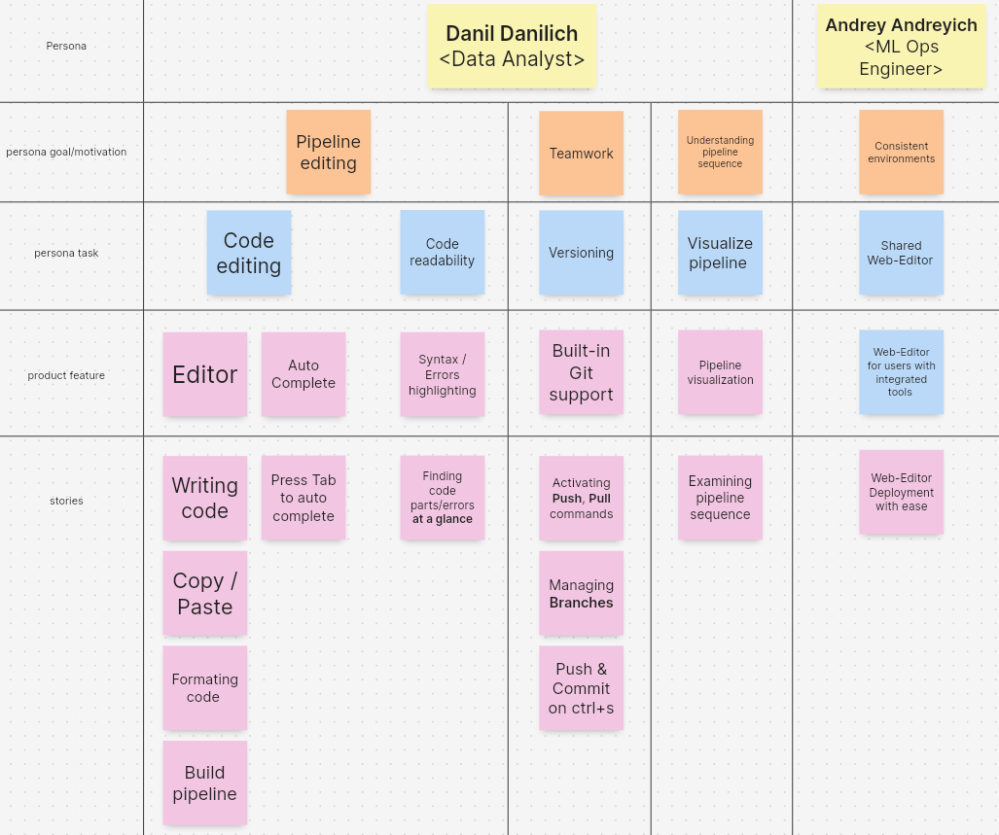
Story map

